Slide 1
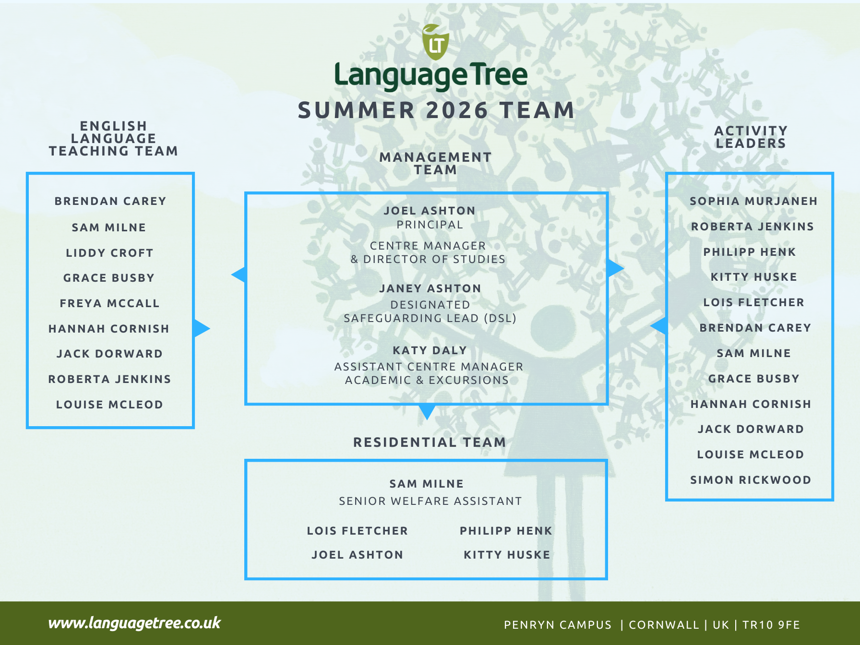

Slide 2
Teacher classes & Student numbers
Adults | Teens
Brendan – Higher level adults (B1-B2) Freya – Lower level adults (A2-B1) Liddy – Advanced adults & closed group | Hannah – Pre-intermediate & Young Learners (A2-B1) Grace – Intermediate (B1 – younger teens, 12-15) Sam – Intermediate (B1 – older teens, 15-17) Jack – Upper-intermediate (B2) Louise – likely to be Intermediate – Upper-intermediate teens Roberta – Teaching practice & observations in Weeks 1 & 2 – levels to be confirmed
29 June | 6 July | 13 July | 20 July | 27 July | 3 August | 10 August | 17 August
20 teens 10 adults | 38 teens 4 YLs 10 adults | 36 teens 5 YLs 20 adults | 60 teens 7 YLs 22 adults | 48 teens 14 adults | 14 teens 16 adults | 12 juniors 5 YLs 14 adults | 10 juniors 8 adults

Slide 3
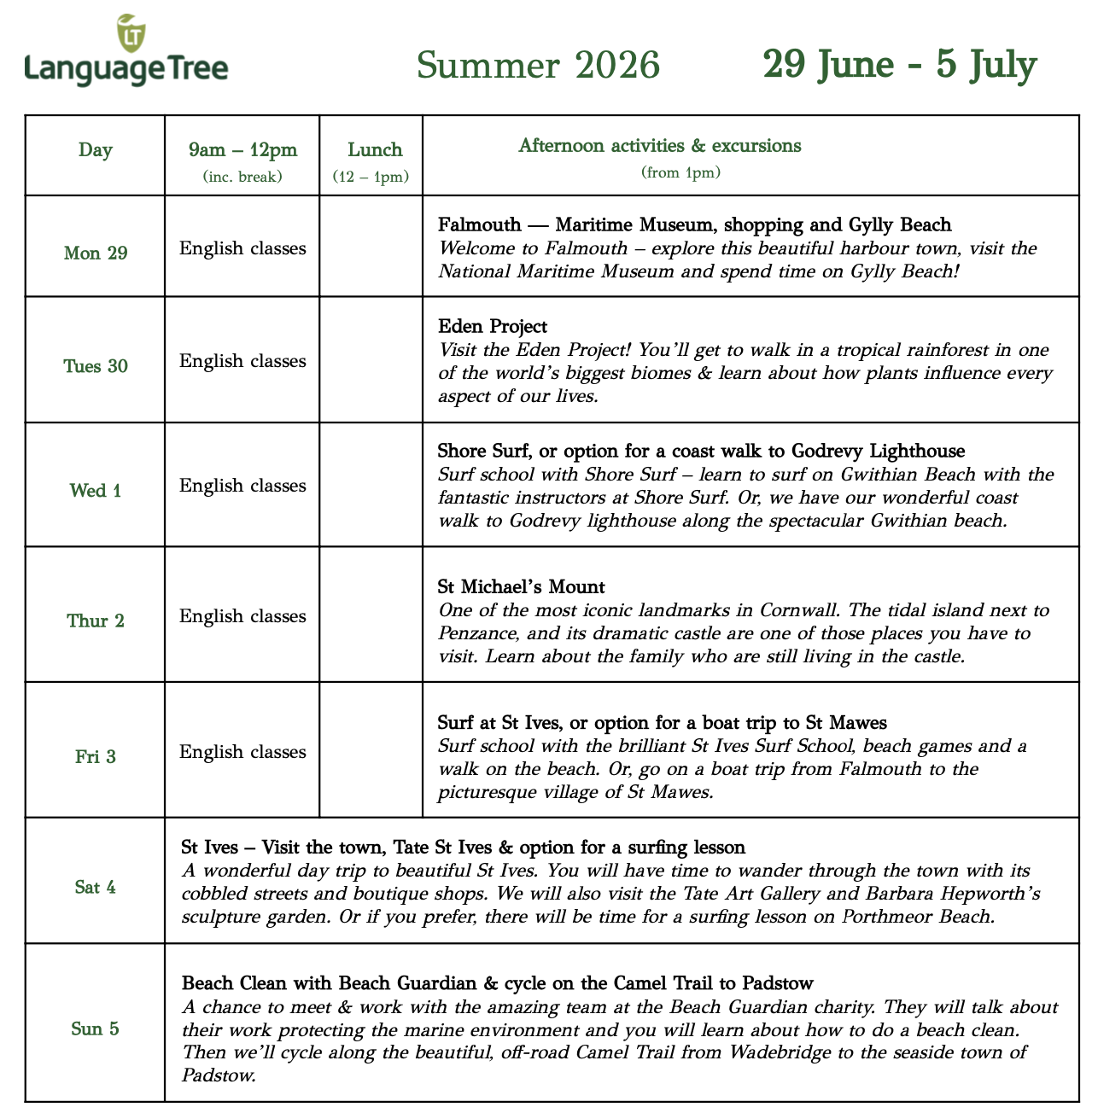
Week 1 & Day 1
Monday morning briefing at 9am
Welcome all students and give a brief overview of the programme & introduce all staff
Teachers will then call registers to take students to their classes by 9.30am
Day 1 is all about going through the Student Handbook, discussing the week plan, orientation on the map, ice-breakers for the class & getting ready for the first excursion to Falmouth
All students will get student notebook, lanyard and wristband
Course books to stay in class

Slide 4
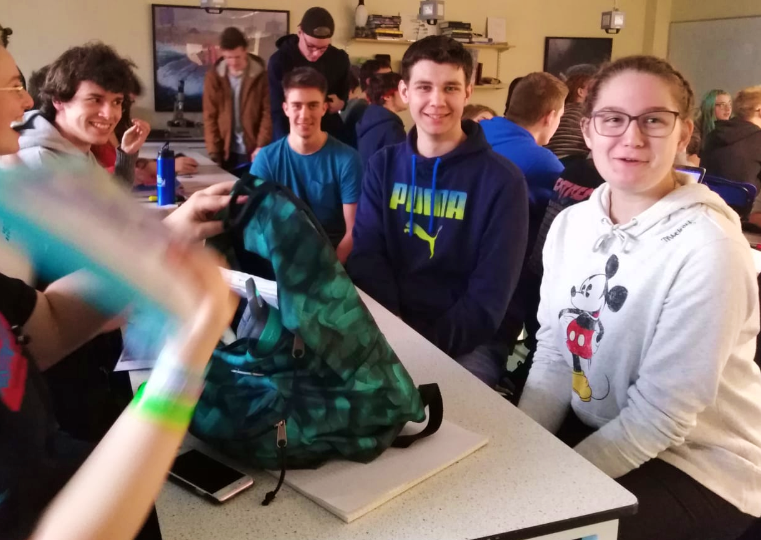
Things to do before next week!
Read the Safeguarding Policy in the Staff Hub
Pack your suncream and swimming costumes!
Don’t get injured or ill
Any questions?

