Slide 1

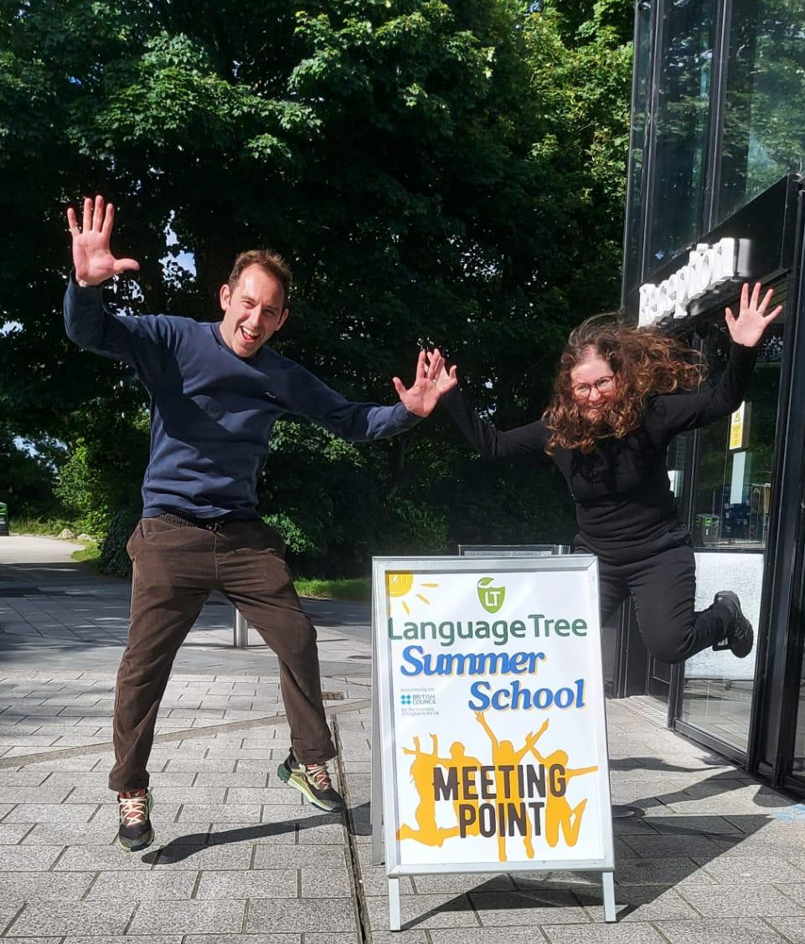


Host Family Zoom
Summer 2026

Slide 2
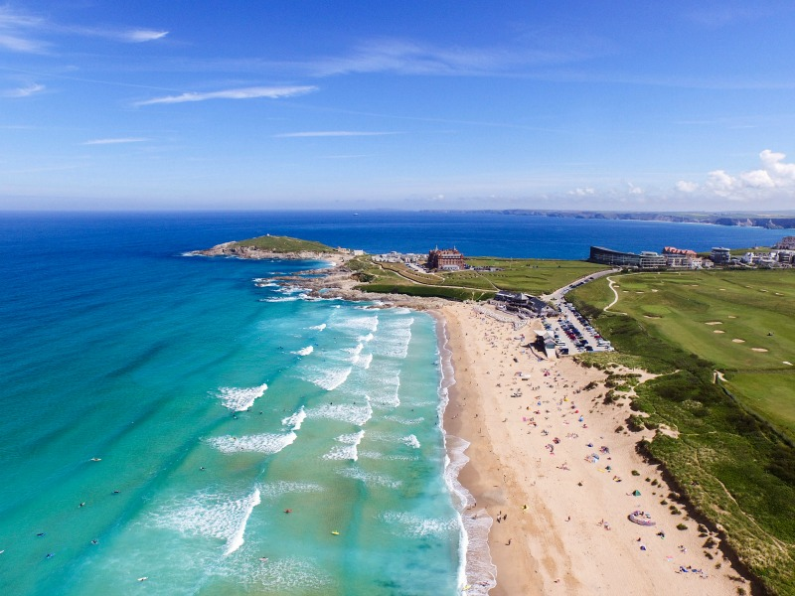
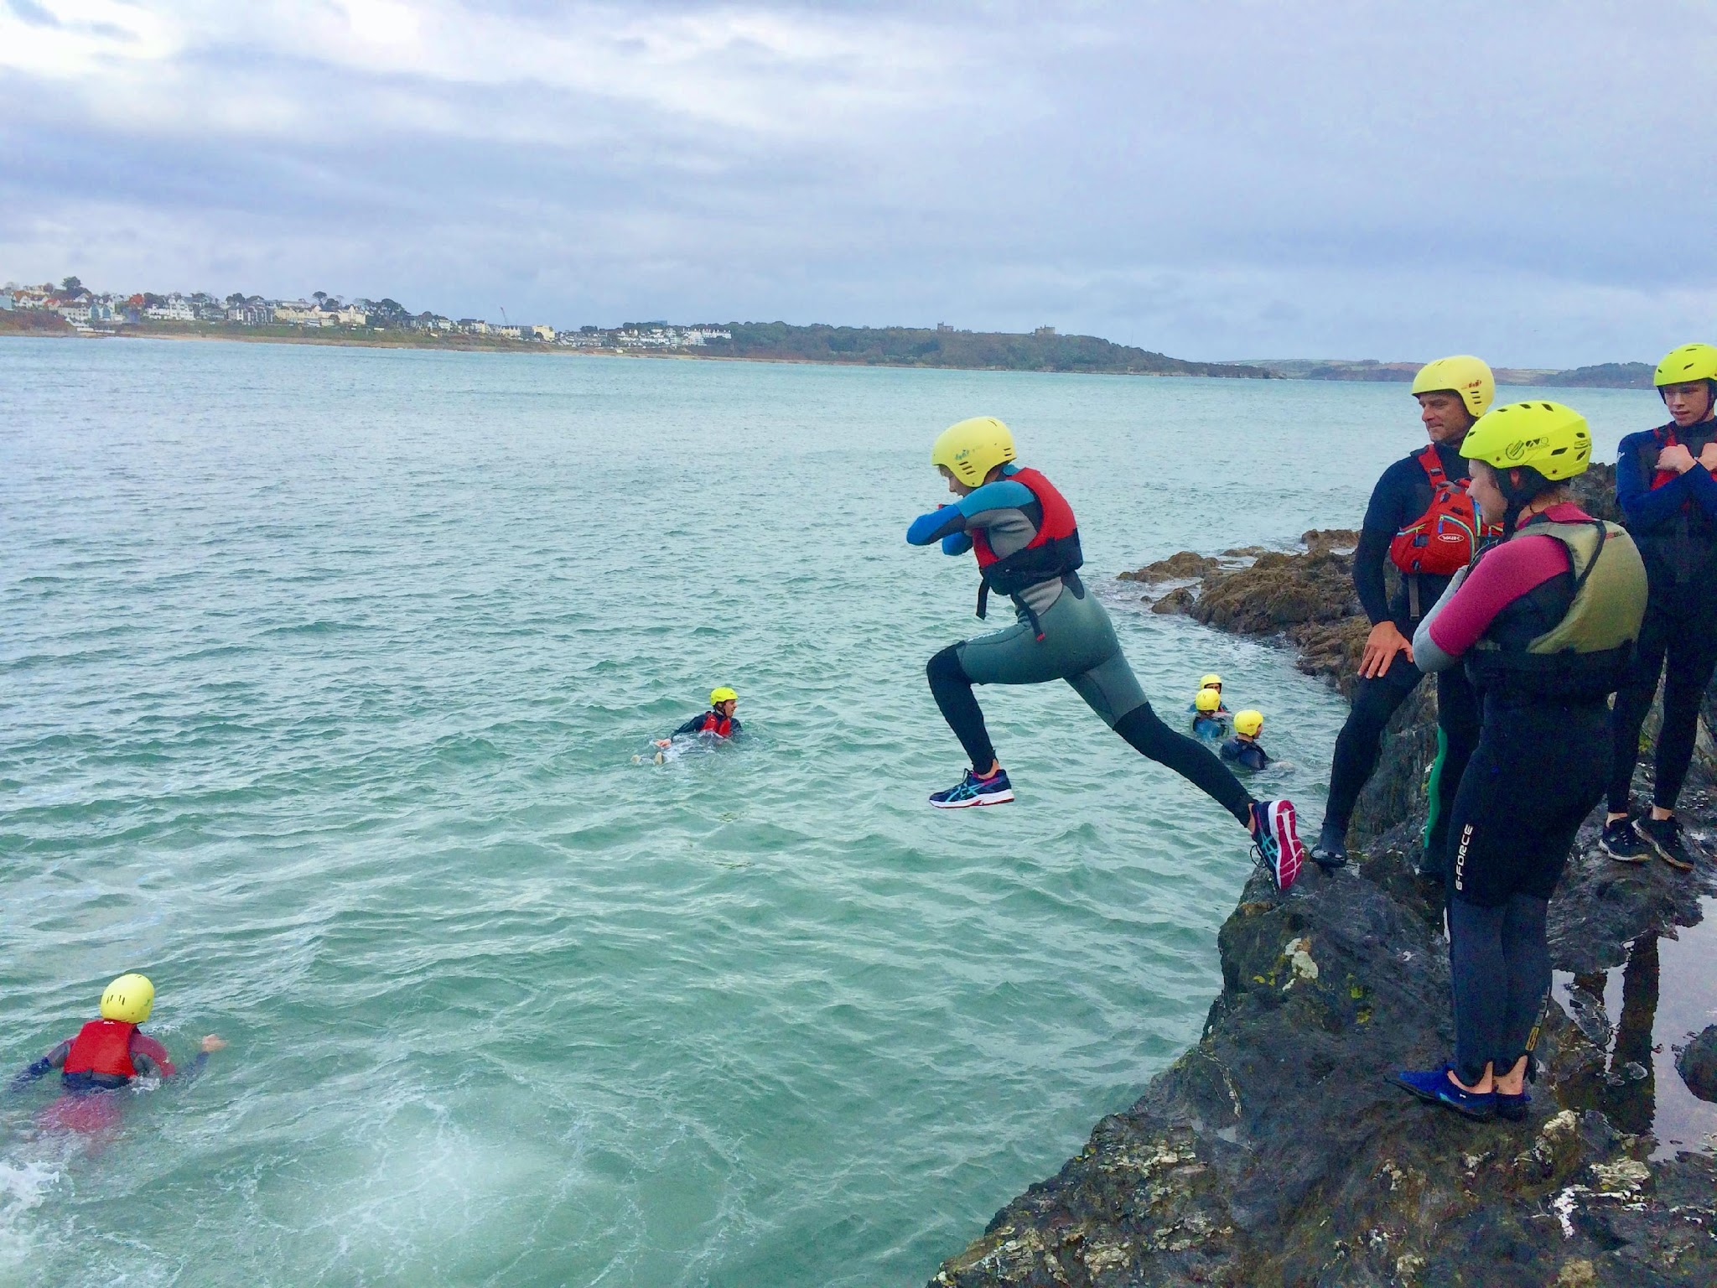

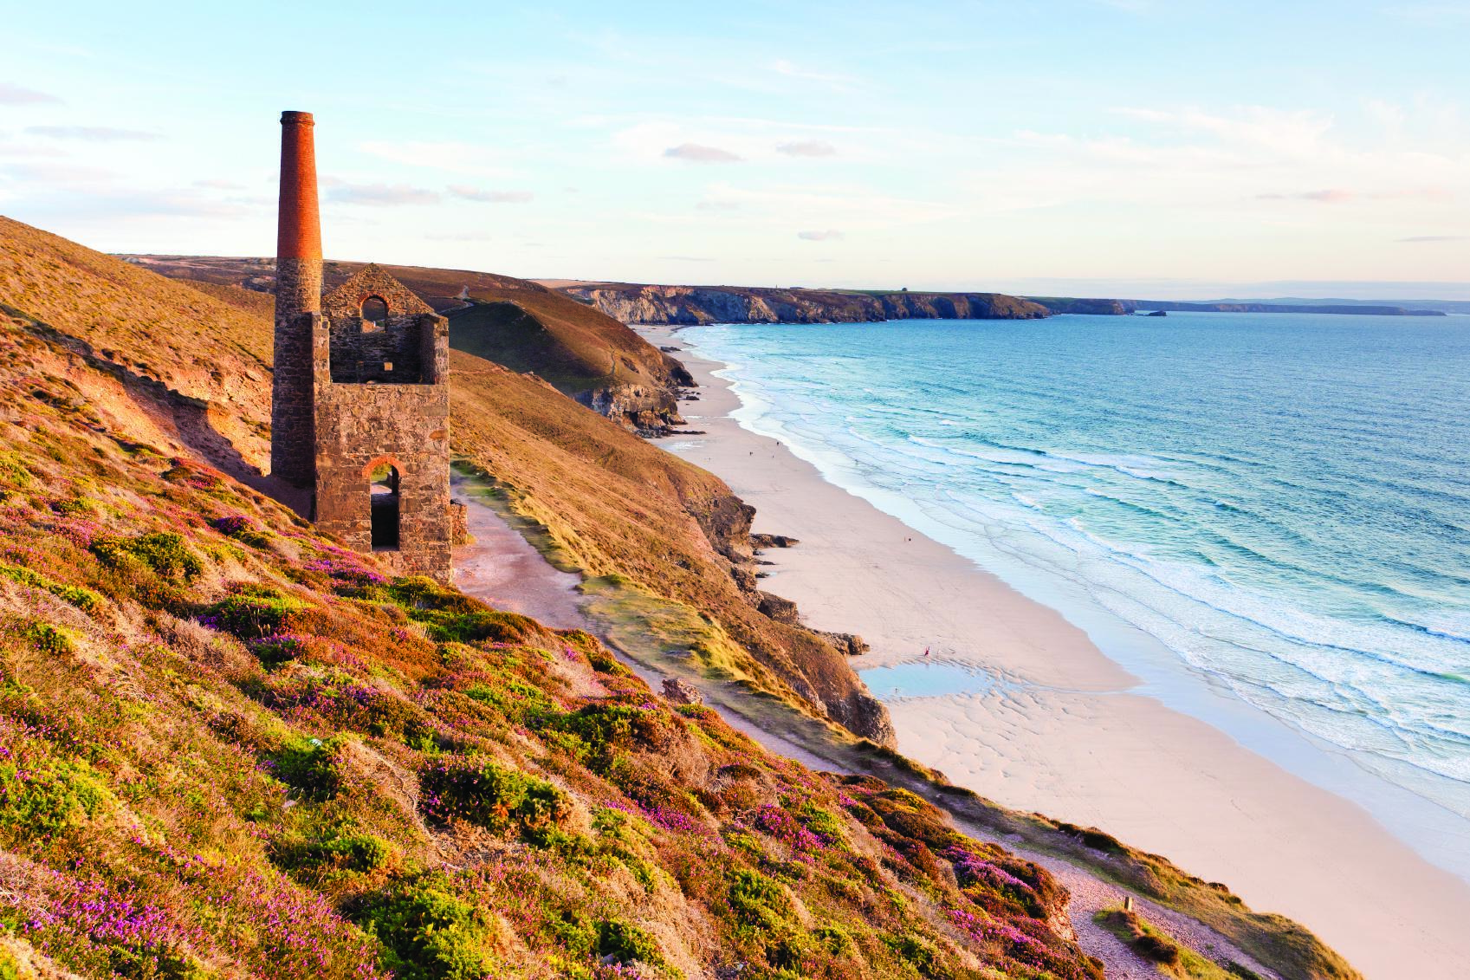
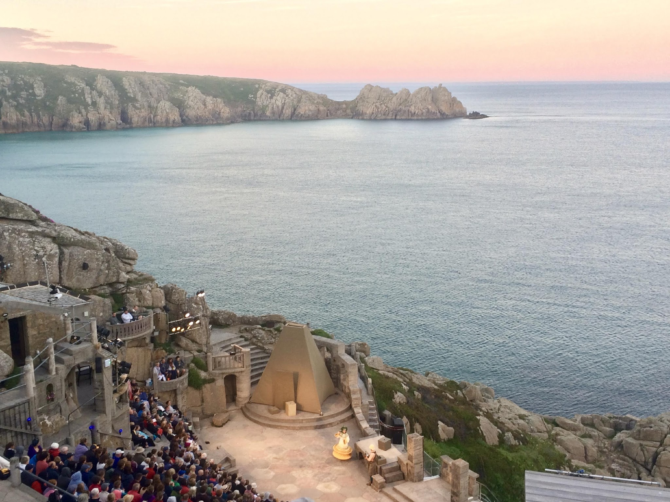
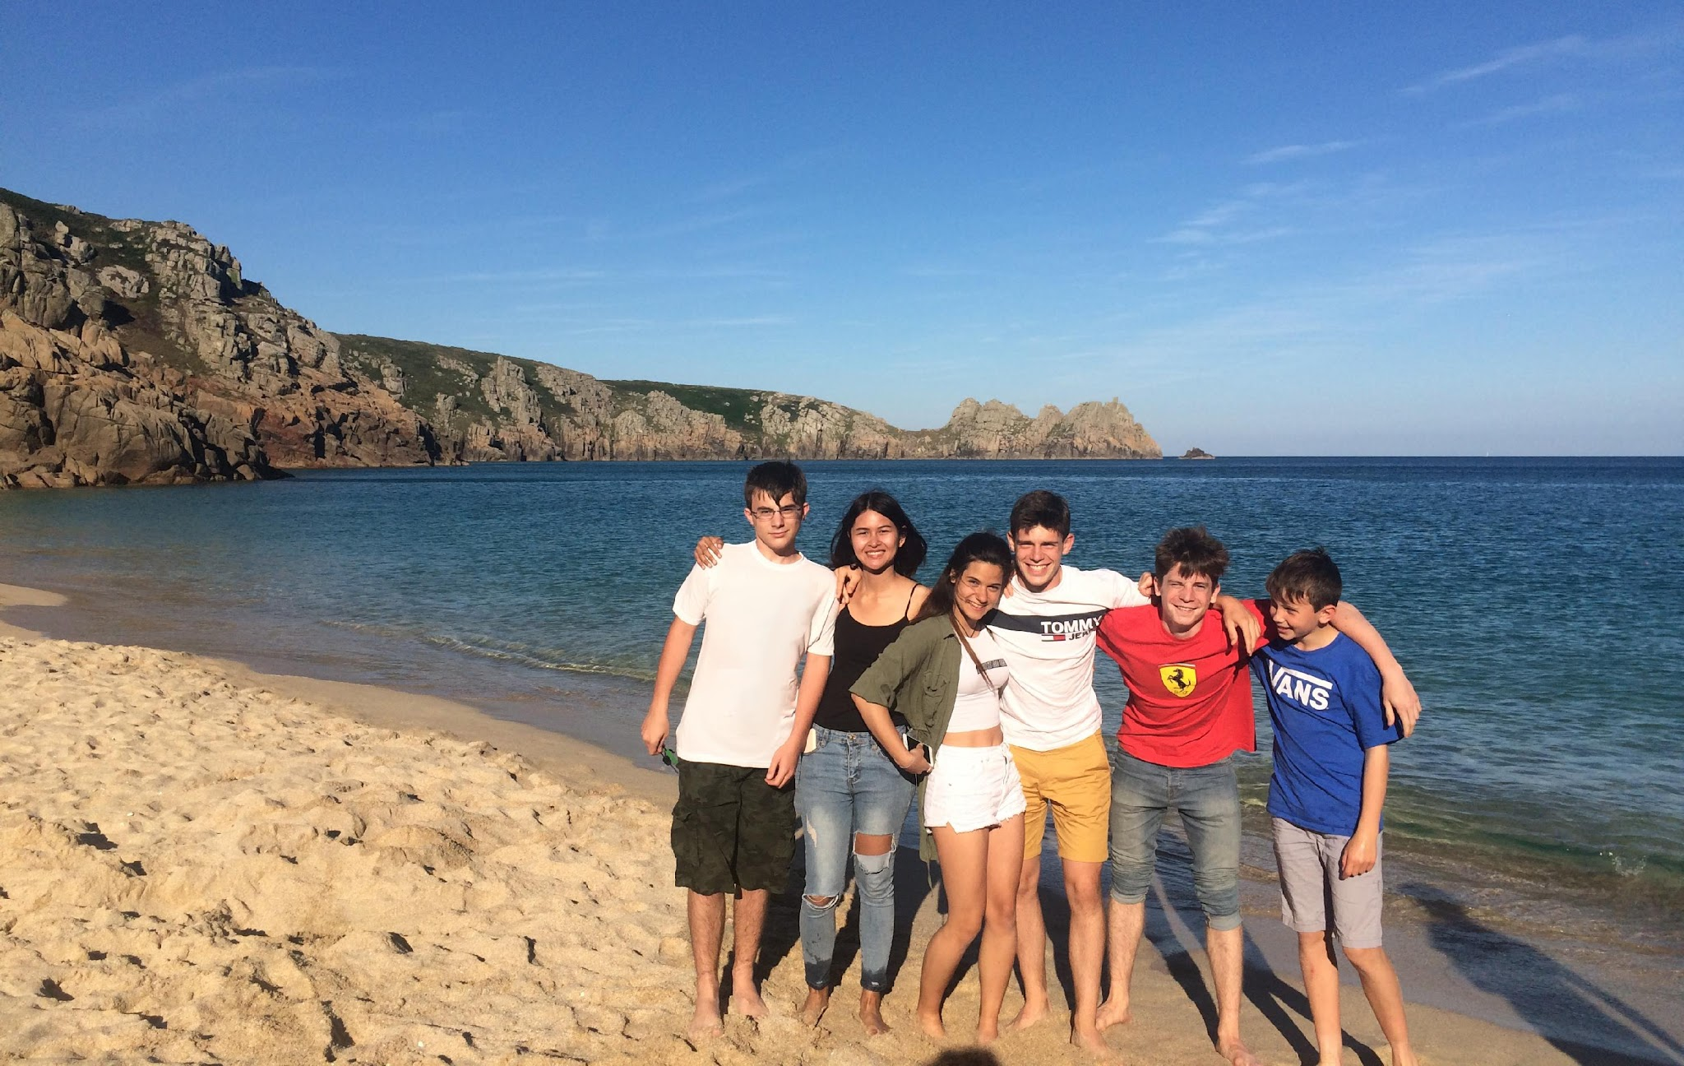


Thank you :)
Without hosts, we couldn’t make all this happen!

Slide 3

Drop off times
Campus: 8:30-8:45am
Truro Sainsbury’s: 8:15am
(next to Amazon lockers opposite the petrol garage)
Pick up times
Campus: roughly 6:30pm
Truro: roughly 7pm**
**could drop at Truro before campus,
e.g. Eden Project
Timetables
10-pin bowling - all eat out - late return to hosts
Cinema night - all eat on campus - late return to hosts

Slide 4

Sundays optional
Packed lunches for
weekends & late night
Minack trips
Swimwear
Timetables

Slide 5

Host group chat use:
Pick up times/ETAs
Updates to timetables, etc
Starting your own conversations in separate chats
  “Drop me a line if you’re near Penmere Station & want to lift share”
  “We’re going to Swanpool this Sunday, message me if you want to join in”
WhatsApp

Slide 6
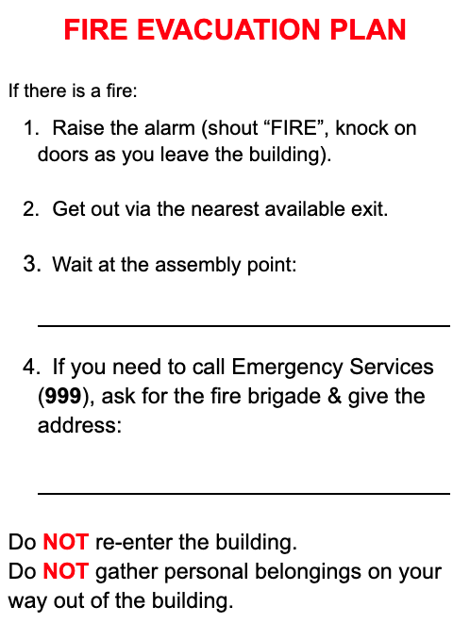
Please ensure you have a Fire Evacuation Plan printed in the room where your student will stay.
Make sure they are familiar with the exit plan from the house.
Fire Evacuation Plan

Slide 7

Let us & parents know!
Call ‘111’ - students are not registered with UK GP
Pharmacy First scheme.
Find out more here
If there’s an emergency, call 999 and then Joel
Sickness & emergencies

Slide 8
Designated Safeguarding Lead
Janey Ashton - 07828 021754
Deputy Safeguarding Lead
Katy Daly - 07450 174694
Principal
Joel Ashton - 07957 497937
Safeguarding
https://languagetreeschool.com/host-hub/

Slide 9

Questions?

